Slide 1
Mobile App
-by
Jyoti Prajapati

Slide 2
Table of contents
Introduction
Evolution of Mobile Apps
Types of Mobile Apps
Development of Mobile Apps
Conclusion

Slide 3
Introduction
Mobile Apps is a software application that is developed of small wireless devices like - smartphones and tablets.
Mobile apps performing specific task for user mobile like - a gallery shows the all pictures, music player only play the songs, gaming apps use to playing games.
Mobile apps try to provide all services of PC/laptops in smartphone and tablets.

Slide 4
Evolution of Mobile Apps
In April of 1973, exactly on the 3rd of this month, Martin Cooper of Motorola made the first call on the mobile phone to Dr.Joel S. Engel of the Bell Labs. This instrument weighed around 1.1 kg.
The R&D department of IBM Simon came up with the first mobile app for Smartphones in 1993 to 1994 exactly two decades after the first call was made.
They made Address Book, calculator, calendar that simple apps.
After that the many companies started the app development.

Slide 5
Types of Mobile Apps
1 )Native apps- are created for one specific platform or operating system.
Technology Used: Native apps are coded using a variety of programming languages. Some examples include: Java, Kotlin, Python, Swift, Objective-C, C++, and React.
2) Web apps - are responsive versions of websites that can work on any mobile device or OS because they’re delivered using a mobile browser.
Technology Used: Web apps are designed using HTML5, CSS, JavaScript, Ruby, and similar programming languages used for web work.
3) Hybrid apps - are combinations of both native and web apps, but wrapped within a native app, giving it the ability to have its own icon or be downloaded from an app store.
Technology Used: Hybrid apps use a mixture of web technologies and native APIs. They’re developed using: Ionic, Objective C, Swift, HTML5, and others.

Slide 6
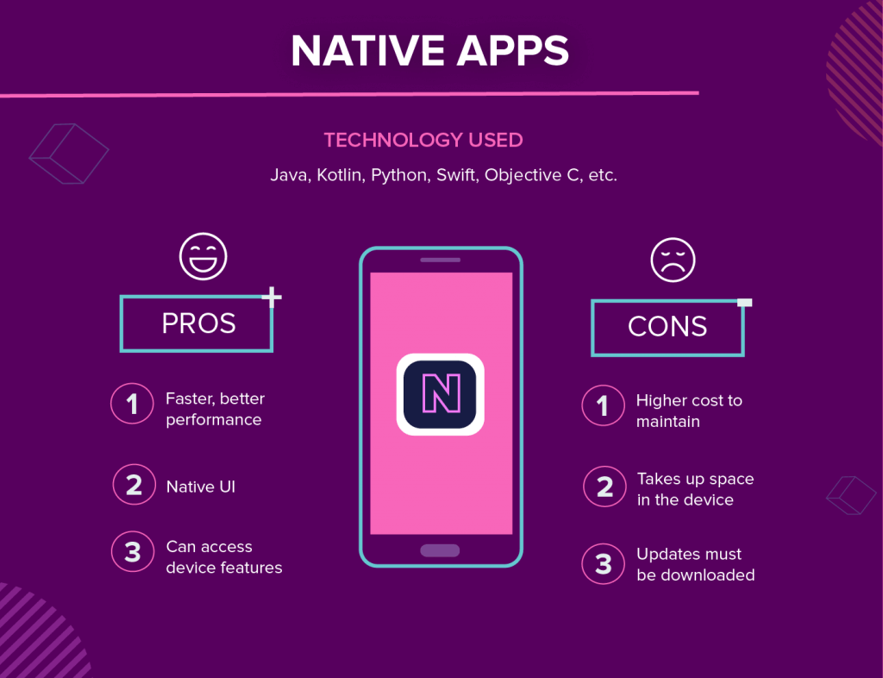

Slide 7
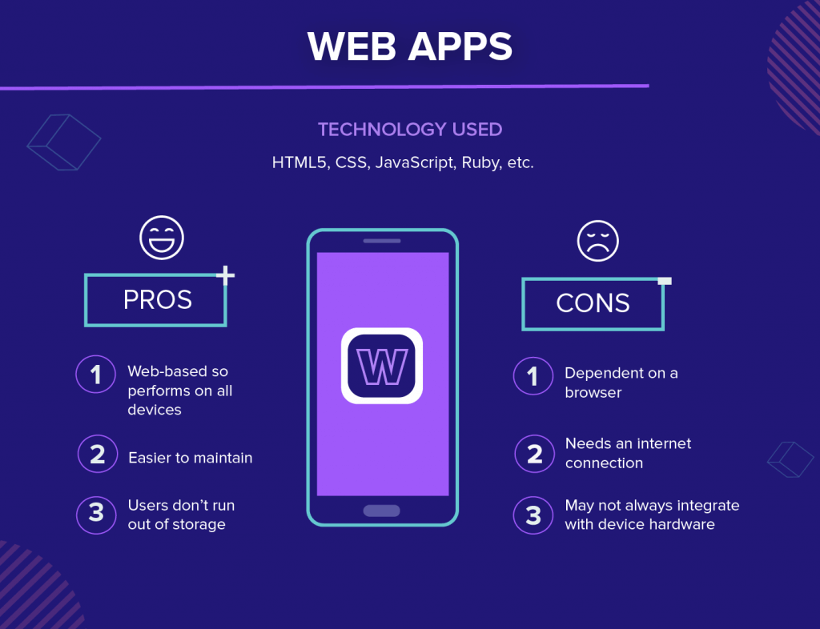

Slide 8
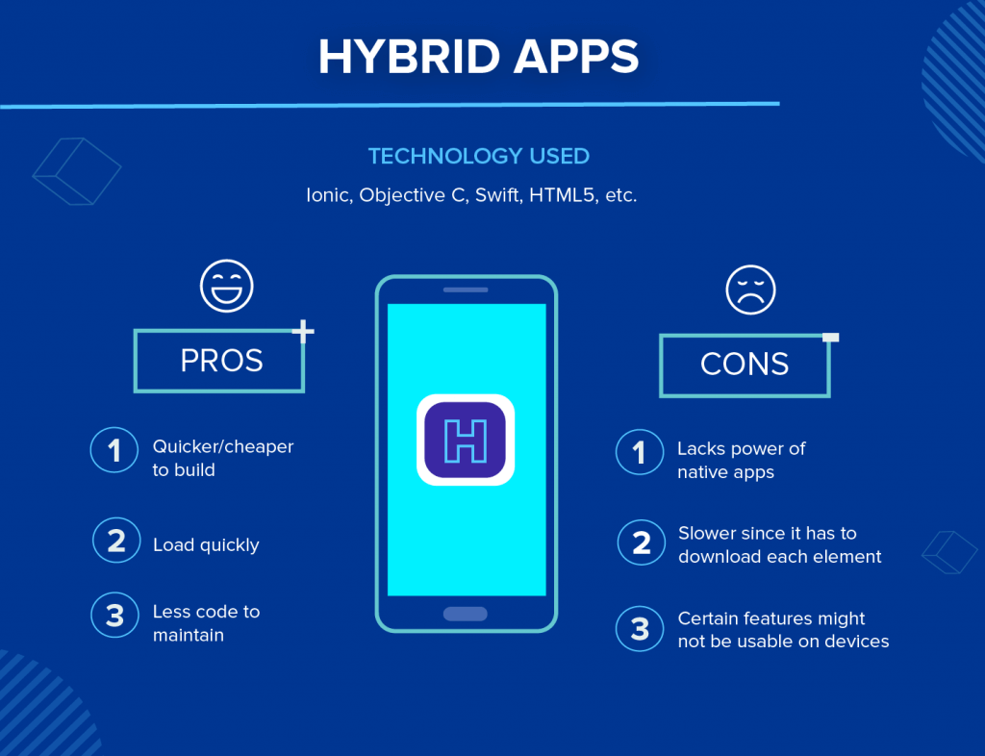

Slide 9
Development of Mobile Apps
Research
Wireframing
Technical Feasibility Assessment
Prototype
Design
Development
Testing
Deployment

Slide 10
Conclusion
Mobile apps are easy to use and easily available on playstore that provide the all laptop/pc services in phone through the phone but before installing the any app you have to check that app ratings and user reviews sometimes app containing viruses that can harm your phone apart from that some hackers made fake apps for their own profit.

Slide 11
Thankyou

